Slide 1
Characterization of Electromagnetic Radiation
■ Molecular Spectroscopy:
It is defined as the study of the interaction of electromagnetic radiation and matter (Molecules, Atoms).
Due to interaction the incident of absorption or emission of electromagnetic radiation by the molecules happens.
Electromagnetic radiation, of which visible light forms an obvious but very small part, may be considered as a simple harmonic wave propagated from a source and travelling in straight lines except when refracted or reflected.
The properties which undulate(up & down motion)—corresponding to the physical displacement of a stretched string vibrating, or the alternate compressions and rarefactions of the atmosphere during the passage of a sound wave— are interconnected electric and magnetic fields.

Slide 2
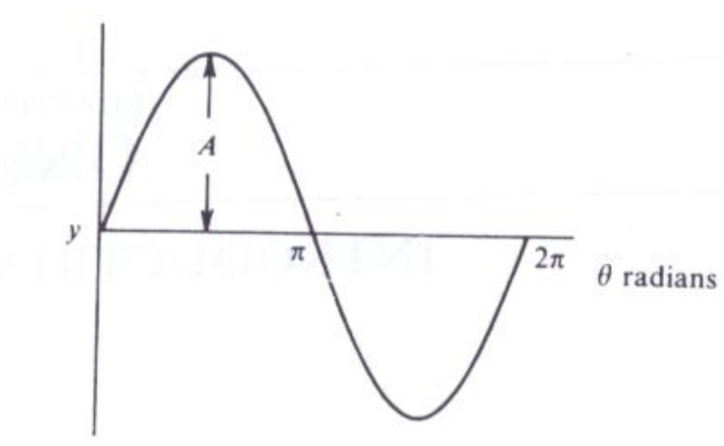

Characterization of Electromagnetic Radiation
It is these undulatory fields which interact with matter giving rise to a spectrum.
Any simple harmonic wave has properties of the sine wave, defined by y = A sin θ. Here y is the displacement with a maximum value A, and θ is an angle varying between 0 and 360 (or 0 and 2n radians).

Slide 3
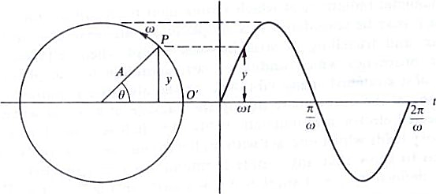
Characterization of Electromagnetic Radiation
A point P travels with uniform angular velocity ω rad s⁻¹ in a circular path of radius A; we measure the time from the instant When P passes O' and then, after a time t seconds, we imagine P to have described an angle θ = ωt [s = vt] radians. Its vertical displacement is then y = A sinθ = A sin ωt, and we can plot this displacement against time as on the right-hand side of Fig. After a time of 2π/ω seconds, P will return to O', completing a 'cycle'.

Slide 4
Characterization of Electromagnetic Radiation
In one second the pattern will repeat itself ω/2π times, and this is referred to as the frequency (ν) of the wave.
The SI unit of frequency is called the hertz (abbreviated to Hz) and has the dimensions of reciprocal seconds (abbreviated s⁻¹). We may then write: then
y = A sin ωt = A sin 2πνt ………….(1)
Basic equation of wave motion.
For the distance variation of the displacement,We need the fundamental distance—time relationship:
x = ct …………..(2)
Where x is the distance covered in time t at a speed c. Combining (1)
and (2) we have:
y = A sin 2πνt = A sin 2πνx/c …………….(3)

Slide 5
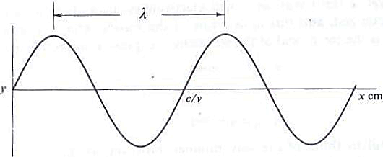

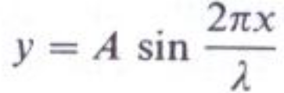
Characterization of Electromagnetic Radiation
Besides the frequency ν, we now have another property by which we can characterize the wave is its wavelength λ, which is the distance travelled during a complete cycle. When the velocity is c metres per second and there are ν cycles per second, there are evidently ν waves in c metres, or

Slide 6


Characterization of Electromagnetic Radiation
In spectroscopy wavelengths are expressed in a variety of units,
In the microwave region, λ is measured in centimeters or millimeters
Infra-red it is usually given in micrometers.
In the visible and ultra-violet region, is still often expressed in Angstrom units (Å).
There is yet a third way in which electromagnetic radiation can be usefully characterized, and this is in terms of the wavenumber ν. Formally this is defined as the reciprocal of the wavelength expressed in centimetres.

Slide 7
The Quantization of Energy
In 1900 Max Planck published the revolutionary idea that the energy of an oscillator is discontinuous and that any change in its energy content can occur only by means of a jump between two distinct energy states. The idea was later extended to cover many other forms of the energy of matter.
A molecule in space can have many sorts of energy; e.g., it may possess rotational energy by virtue of bodily rotation about its centre of gravity; it will have vibrational energy due to the periodic displacement of its atoms from their equilibrium positions; it will have electronic energy since the electrons associated with each atom or bond are in unceasing motion, etc.
Electron can exist in one of several discrete energy levels: the energy as being quantized.

Slide 8
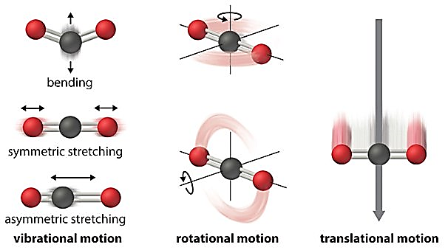
The Quantization of Energy
In much the same way the rotational, vibrational, and other energies of a molecule are also quantized—a particular molecule can exist in a variety of rotational, vibrational, etc., energy levels and can move from one level to another only by a sudden jump involving a finite amount of energy.

Slide 9
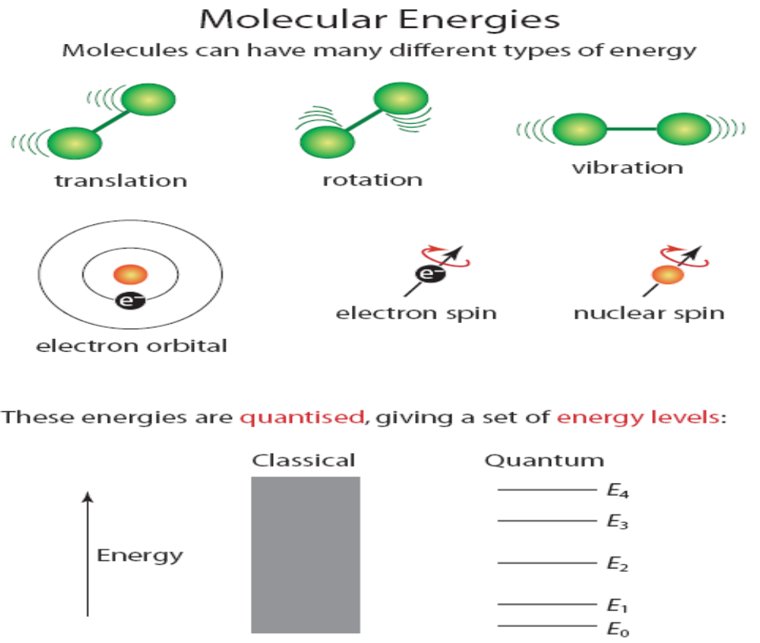
The Quantization of Energy

Slide 10
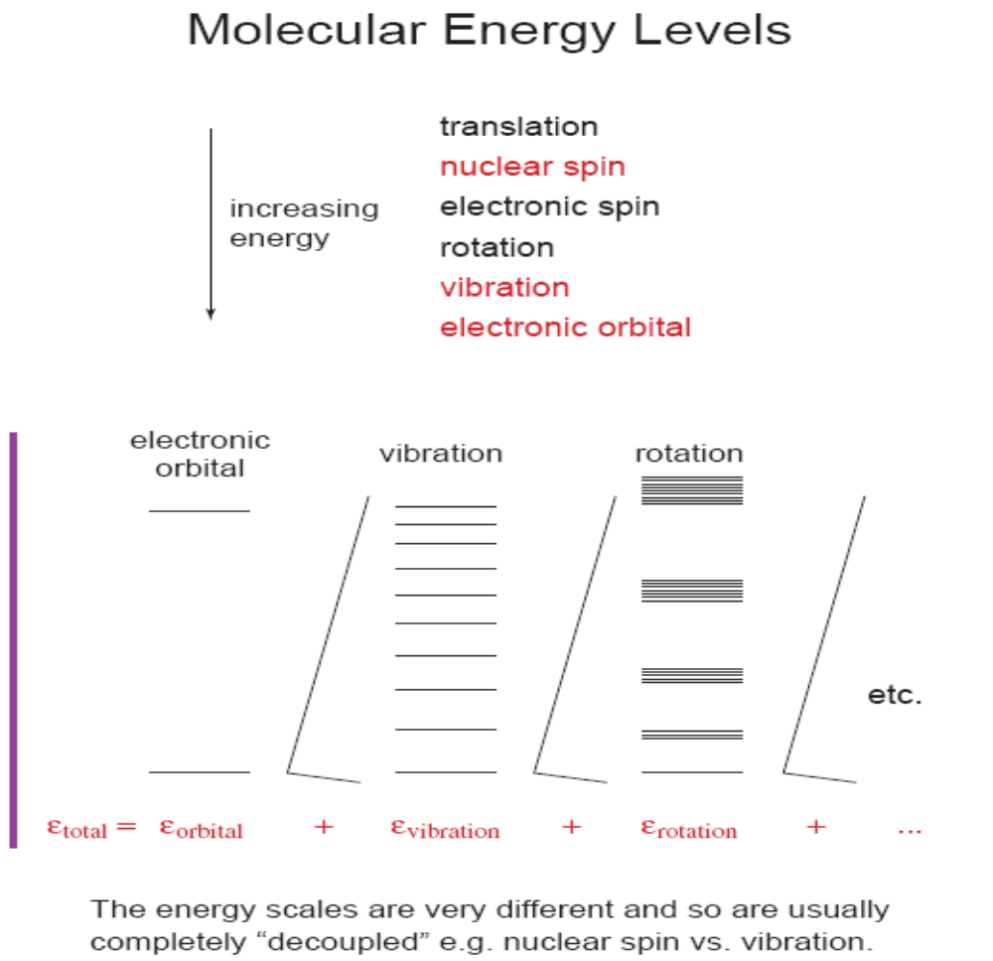
The Quantization of Energy

Slide 11
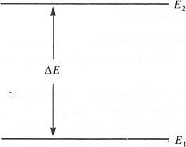
The Quantization of Energy
Consider two possible energy states of a system—two rotational energy levels of a molecule, for example—labelled E_{l} and E₂ in the following diagram. The suffixes 1 and 2 used to distinguish these levels are in fact quantum numbers.
Transitions can take place between the levels E_{l} and E₂ provided the appropriate amount of energy, ΔE = E₂ — E_{l}, can be either absorbed or emitted by the system.

Slide 12
The Quantization of Energy
Planck suggested that such absorbed or emitted energy can take the form of electromagnetic radiation and that the frequency of the radiation has the simple form:
ν = ΔE / h Hz
i.e., ΔE = hν Joules
where we express our energies E in terms of the joule, and h is a universal constant—Planck's constant.
The significance of this is that if we take a molecule in state I and direct on to it a beam of radiation of a single frequency v (monochromatic radiation), where v = ΔE/h, energy will be absorbed from the beam and the molecule will jump to state 2. A detector placed to collect the radiation after its interaction with the molecule will show that its intensity has decreased.

Slide 13
The Quantization of Energy
Also if we use a beam containing a wide range of frequencies ('white' radiation), the detector will show that energy has been absorbed only from that frequency v = ΔE/h, all other frequencies being undiminished in intensity. In this way we have produced a spectrum—an absorption spectrum.
Alternatively the molecule may already be in state 2 and may revert to state 1 with the consequent emission of radiation. A detector would show this radiation to have frequency v = Δ E/h only, and the emission spectrum so found is plainly complementary to the absorption spectrum of the previous paragraph.
The actual energy differences between the rotational, vibrational, and electronic energy levels are very small and may be measured in joules per molecule (or atom).

Slide 14
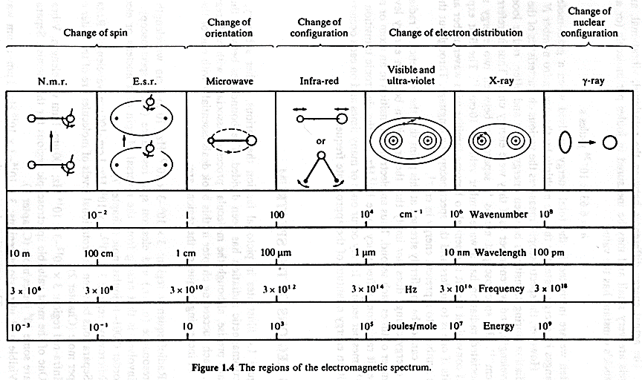
Regions of the Spectrum
The following figure illustrates the various, rather arbitrary, regions into which electromagnetic radiation has been divided.

Slide 15
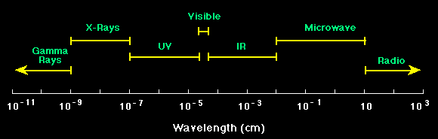
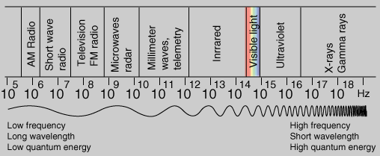
Regions of the Spectrum

Slide 16
Regions of the Spectrum
Radiofrequency region: 3 x 10⁶ to 3 x 10¹⁰ Hz; 10 m to 1 cm wavelength. Nuclear magnetic resonance (n.m.r.) and electron spin resonance (e.s.r.) spectroscopy. The energy change involved is that arising from the reversal of spin of a nucleus or electron, and is of the order 0.001—10 joules/mole.
Microwave region: 3 x 10¹⁰ to 3 x 10¹² Hz; 1 cm to 100 μm wavelength. Rotational spectroscopy. Separations between the rotational levels of molecules are of the order of hundreds of joules per mole.
Infra-red region: 3 x 10¹² to 3 x 10¹⁴ Hz; 100 μm to1 μm wavelength. Vibrational spectroscopy. One of the most valuable spectroscopic regions for the chemist. Separations between levels are some 10⁴ joules/ mole

Slide 17
Regions of the Spectrum
Visible and ultra-violet regions: 3 x 10¹⁴ to 3 x 10¹⁶ Hz; 1 μm to 10 nm wavelength. Electronic spectroscopy. The separations between the energies of valence electrons are some hundreds of kilojoules per mole.
X-ray region: 3 x 10¹⁶ to 3 x 10¹⁸ Hz; 10 nm to 100 pm wavelength. Energy changes involving the inner electrons of an atom or a molecule, which may be of order ten thousand kilojoules
γ-ray region: 3 x 10¹⁸ to 3 x 10²⁰ Hz; 100 pm to 1 pm wavelength. Energy changes involve the rearrangement of nuclear particles, having energies of 10⁹ to 10 ¹¹ joules per gram atom.
One other type Of spectroscopy, that discovered by Raman and bearing his name.

Slide 18
Regions of the Spectrum
Due to the interaction between the incident radiation and the nuclear, molecular, or electronic changes, there must be some electric or magnetic effect produced by the change which can be influenced by the electric or magnetic fields associated with the radiation. There are several possibilities:
The radiofrequency region. We may consider the nucleus and electron to be tiny charged particles, and it follows that their spin is associated with a tiny magnetic dipole. The reversal of this dipole consequent upon the spin reversal can interact with the magnetic field of electromagnetic radiation at the appropriate frequency. Consequently all such spin reversals produce an absorption or emission spectrum.

Slide 19
Regions of the Spectrum
The visible and ultra-violet region: The excitation of a valence electron involves the moving of electronic charges in the molecule. The consequent change in the electric dipole gives rise to a spectrum by its interaction with the undulatory electric field of radiation.
The microwave region. A molecule such as hydrogen chloride, HCI, in which one atom (the hydrogen) carries a permanent net positive charge and the other a net negative charge, is said to have a permanent electric dipole moment. H₂ or Cl₂, on the other hand, in which there is no such charge separation, have a zero dipole.

Slide 20
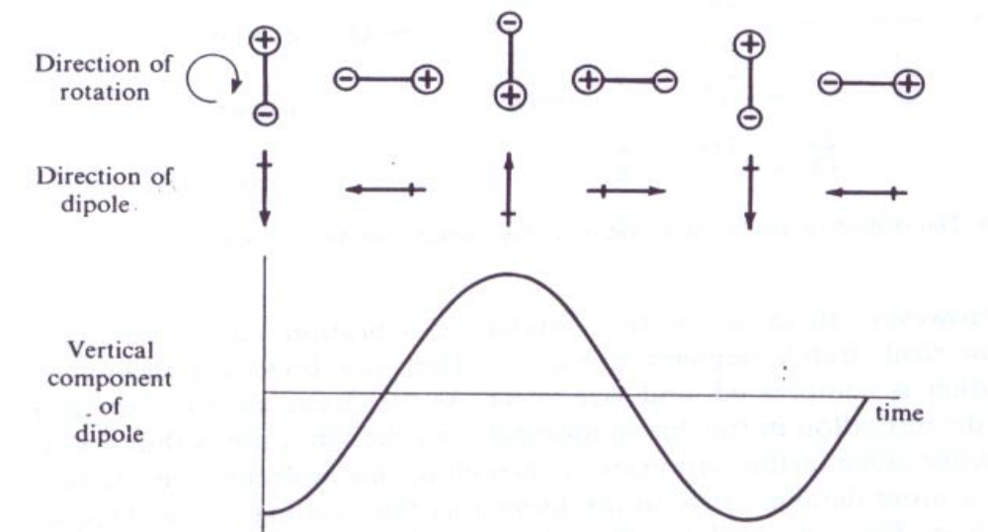
Regions of the Spectrum
Due to the rotation of HCI, the component dipole moment in a given direction (say upwards in the plane of the paper) fluctuates regularly. This fluctuation is plotted in the lower half of Fig and it is seen to be exactly similar in form to the fluctuating electric field of radiation.
Thus interaction can occur, energy can be absorbed or emitted, and the rotation gives rise to a spectrum. All molecules having a permanent moment are said to be 'microwave active'.

Slide 21
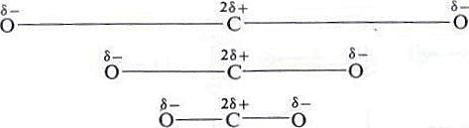
Regions of the Spectrum
The infra-red region: Here it is a vibration, rather than a rotation, which must give rise to a dipole change. Consider the carbon dioxide molecule, in which the three atoms are arranged linearly with a small net positive charge on the carbon and small negative charges on the oxygens:
During the mode of vibration known as the 'symmetric stretch', the molecule is alternately stretched and compressed, both C—O bonds changing simultaneously. The dipole moment remains zero throughout the whole of this motion, and this particular vibration is thus 'infra-red inactive'.
stretched normal compressed

Slide 22
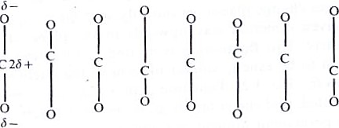
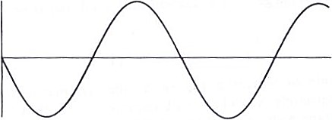
Regions of the Spectrum
There is another stretching vibration called the antisymmetrical stretch. Here one bond stretches while the other is compressed, and vice versa. As the figure shows, there is a periodic alteration in the dipole moment, and the vibration is thus 'infrared active'.
Component of dipole
The asymmetric stretching vibration of the carbon dioxide molecule
showing the fluctuation in the dipole moment.

Slide 23

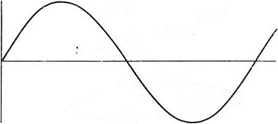
Regions of the Spectrum
Bending vibration
The bending motion of the carbon dioxide molecule and its associated dipole fluctuation.
There is a rather special requirement for a molecular motion to be 'Raman active'; this is that the electrical polarizability of the molecule must change during the motion.

Slide 24
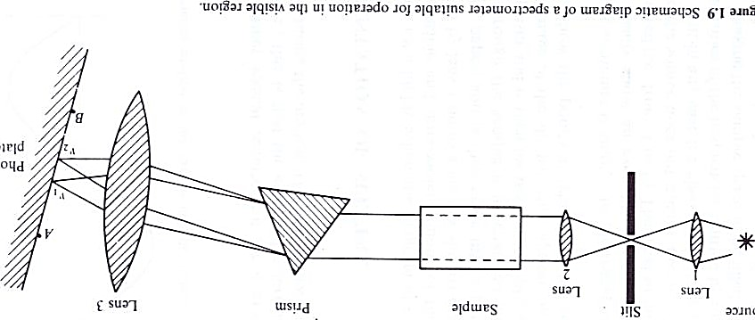
Representation of Spectra
The following figure a highly schematic diagram of a spectrometer suitable for use in the visible and ultra-violet regions of the spectrum. A 'white' source is focused by lens I on to a narrow slit (arranged perpendicularly to the plane of the paper) and is then made into a parallel beam by lens 2. After passing through the sample it is separated into its constituent frequencies by a prism and is then focused on to a photographic plate by lens 3; the vertical image of the slit will thus appear on the plate. Rays have been drawn to show the points at which two frequencies, v₁ and v₂, are focused.

Slide 25
Representation of Spectra
If the sample container is empty, the photographic plate, after development, should ideally show an even blackening over the whole range of frequencies covered (i.e., from A to B).
If we now imagine the sample space to be filled with a substance having only two possible energy levels, E_{l} and E₂, the photographic plate, after development, will show a blackening at all points except at the frequency v = (E₂ — E_{l})/h, since energy at this frequency will have been absorbed by the sample in raising each molecule from state 1 to state 2.
Further if, as is almost always the case, there are many possible energy levels, E₁, E₂….. E_{j}, E_{k},…. available to the sample, a series of absorption lines will appear on the photographic plate at frequencies given by v = (E_{j} — E_{k})/h.

Slide 26
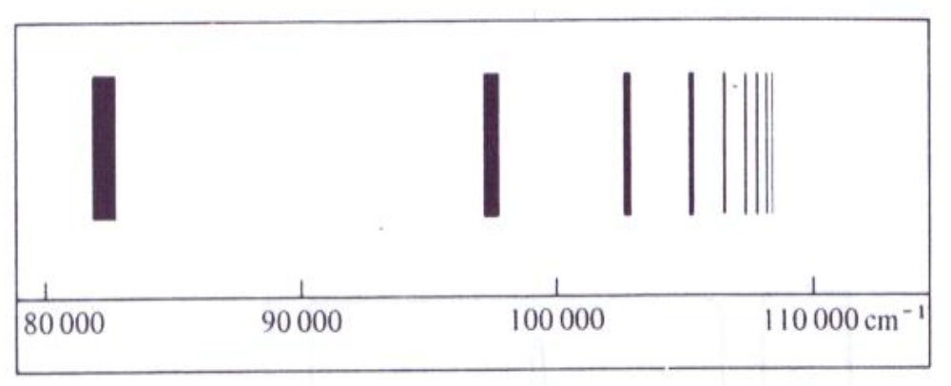
Representation of Spectra
Figure: Schematic diagram of the absorption spectrum of atomic hydrogen recorded on a photographic plate.
In the ultra-violet, visible, and infra-red regions it is an experimental fact that a given sample continues to show an absorption spectrum for as long as we care to irradiate it—in other words, a finite number of sample molecules appear to be capable of absorbing an infinite amount of energy. Plainly the molecules must be able to rid themselves of the absorbed energy.

Slide 27
Representation of Spectra
A possible mechanism for this is by thermal collisions. An energized molecule collides with its neighbours and gradually loses its excess energy to them as kinetic energy—the sample as a whole becomes warm.
Another mechanism is that energy gained from radiation is lost as radiation once more. A molecule in the ground state absorbs energy at frequency v and its energy is raised an amount ΔE = hv above the ground state. It is thus in an excited, unstable condition, but by emitting radiation of frequency v again, it can revert to the ground state and is able to reabsorb from the radiation beam once more.

Slide 28
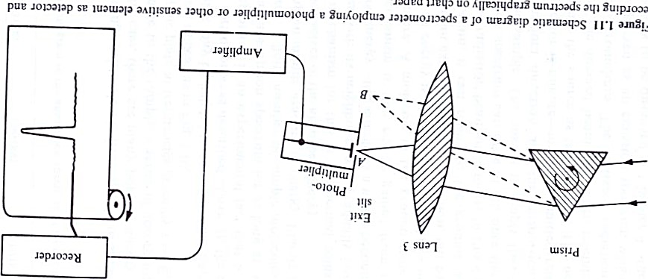
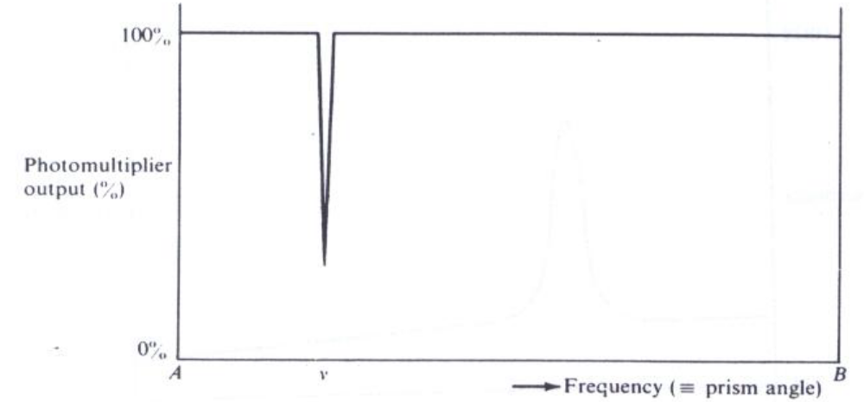
Representation of Spectra
The idealized spectrum of a molecule undergoing a single transition.

Slide 29
Representation of Spectra
In modern spectrometers the detector is rarely the simple photographic plate. One of the most sensitive and useful devices in the visible and ultra-violet region is the photomultiplier tube, consisting of a light-sensitive surface which emits electrons when light falls upon it. The tiny electron current may be amplified and applied to an ammeter or pen recorder.
Again, the ideal situation of spectrum of the molecule is seldom attained. Not only does the source emissivity vary with frequency, but often the sensitivity of the photomultiplier is also frequency-dependent.
Since it is impossible to make either of the slits infinitely narrow, a range of frequencies, rather than just a single frequency, falls on the photomultiplier at any given setting of the prism. This results in a broadening of the absorbance peak.

Slide 30
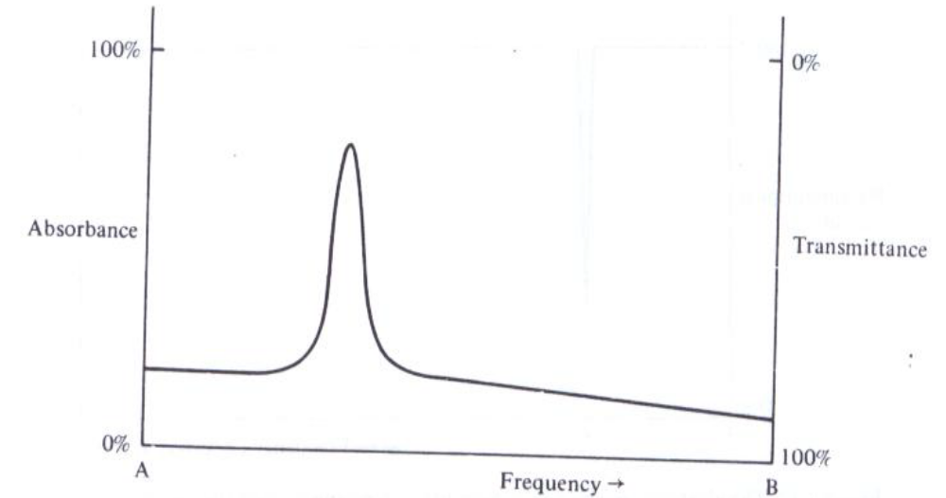
Representation of Spectra
The usual appearance of the spectrum of a molecule undergoing a single transition; here the background is no longer constant and the absorption region is of finite width.
we have plotted absorbance upwards from O to 100% and transmittance—its complement—downwards. This is the usual way in which such spectra are represented

Slide 31
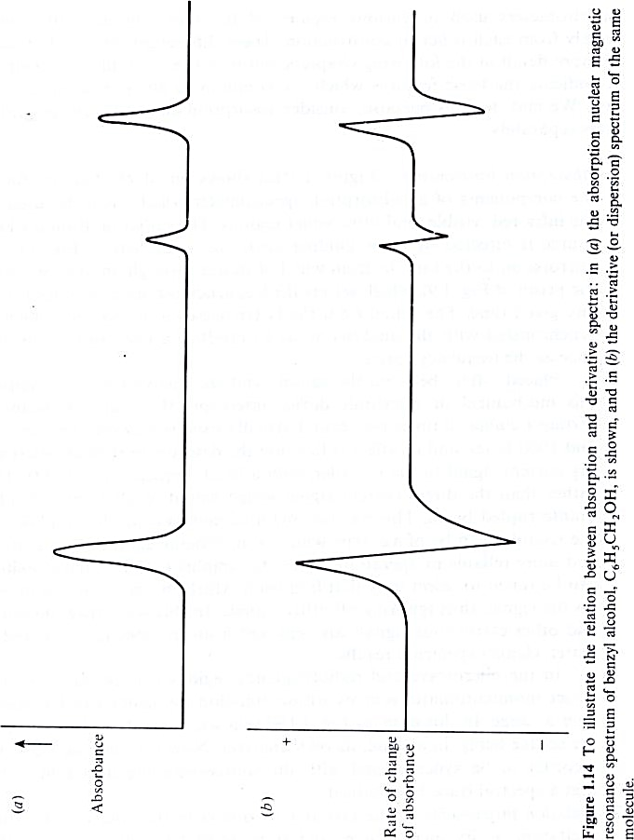
Representation of Spectra
The derivative of a curve is simply its slope at a given point. In calculus notation, the derivative of the spectral trace is dA/dv, where A is the absorbance. The derivative record is thus a plot of the slope dA/dv against v

Slide 32
Basic Elements of Practical Spectroscopy
Spectrometers used in various regions of the spectrum naturally differ widely from each other in construction. but here we show the basic features which are common' to all types of spectrometer.
Absorption instruments:
The figure shows, in block diagram form, the components of an absorption spectrometer which might be used in the infra-red, visible, and ultra-violet regions.
The radiation from a white source is directed by some guiding device (e.g., the lens of Fig. 1.9, or mirrors) on to the sample, from which it passes through an analyzer (e.g., the prism of Fig. 1.9), which selects the frequency reaching the detector at any given time.

Slide 33
Basic Elements of Practical Spectroscopy
Absorption instruments:
A modulator; this mechanical or electronic device interrupts the radiation beam a certain number of times per second, usually fixed somewhere between 10 and 1000 times, and its effect is to cause the detector to send an alternating current signal to the recorder, with a fixed frequency of 10-1000 Hz, rather than the direct current signal which would result from a steady, uninterrupted beam.
In the microwave and radiofrequency regions it is possible to construct monochromatic sources whose emission frequency can be varied over a range. In this case, no analyzer is necessary, the source being, in a sense, its own analyzer.

Slide 34
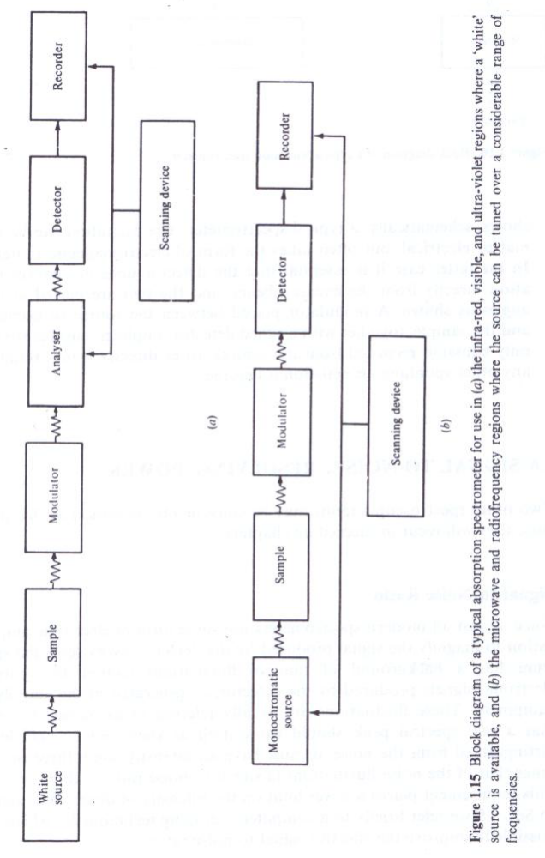
Basic Elements of Practical Spectroscopy

Slide 35
Basic Elements of Practical Spectroscopy
Emission instruments:
The layout now differs in that the sample, after excitation, is its own source, and it is necessary only to collect the emitted radiation, analyze, and record it in the usual way.
The excitation can be thermal or electrical, but often takes the form of electromagnetic radiation.
A modulator placed between the source of excitation and the sample, together with a tuned detector-amplifier, ensures that the only emission recorded from the sample arises directly from excitation; any other spontaneous emission is ignored.

Slide 36
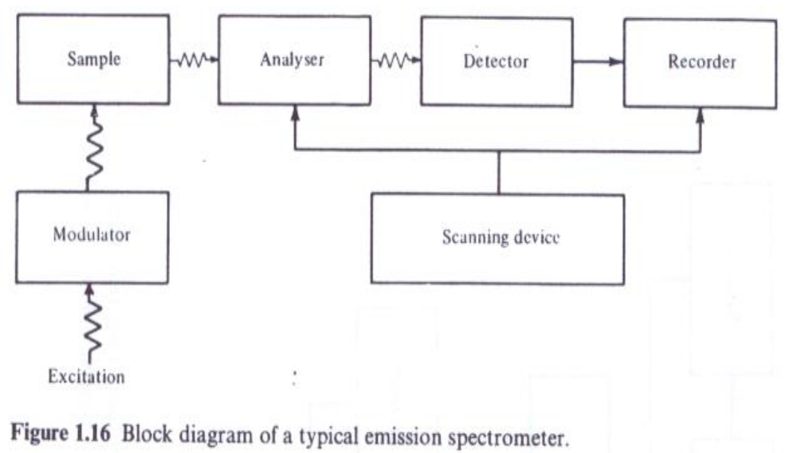
Basic Elements of Practical Spectroscopy

Slide 37
Signal-to-Noise: Resolving Power
Signal-to-Noise Ratio:
Since almost all modern spectrometers use some form of electronic amplification to magnify the signal produced by the detector, every recorded spectrum has a background of random fluctuations caused by spurious(False) electronic signals produced by the detector, or generated in the amplifying equipment.
These fluctuations are usually referred to as 'noise'.
A real spectral peak should show itself as such and be sufficiently distinguished from the noise, it must have an intensity some three or four times that of the noise fluctuations (a signal-to-noise ratio of three or four).

Slide 38
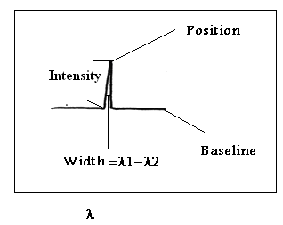
Signal-to-Noise: Resolving Power

Slide 39
Signal-to-Noise: Resolving Power
Resolving Power:
The term used as a measure of the performance of a spectrometer.
Ability of a spectrometer to resolve / separate adjacent peaks in a spectrum.
No molecular absorption takes place at a single frequency only, but always over a spread of frequencies, usually very narrow but sometimes quite large.
Let us consider two such lines close together, as on the right of Fig. (a): the dotted curve represents the absorption due to each line separately, the full line their combined absorption. We shall first take the exit slit width to be larger than the separation between the lines.

Slide 40
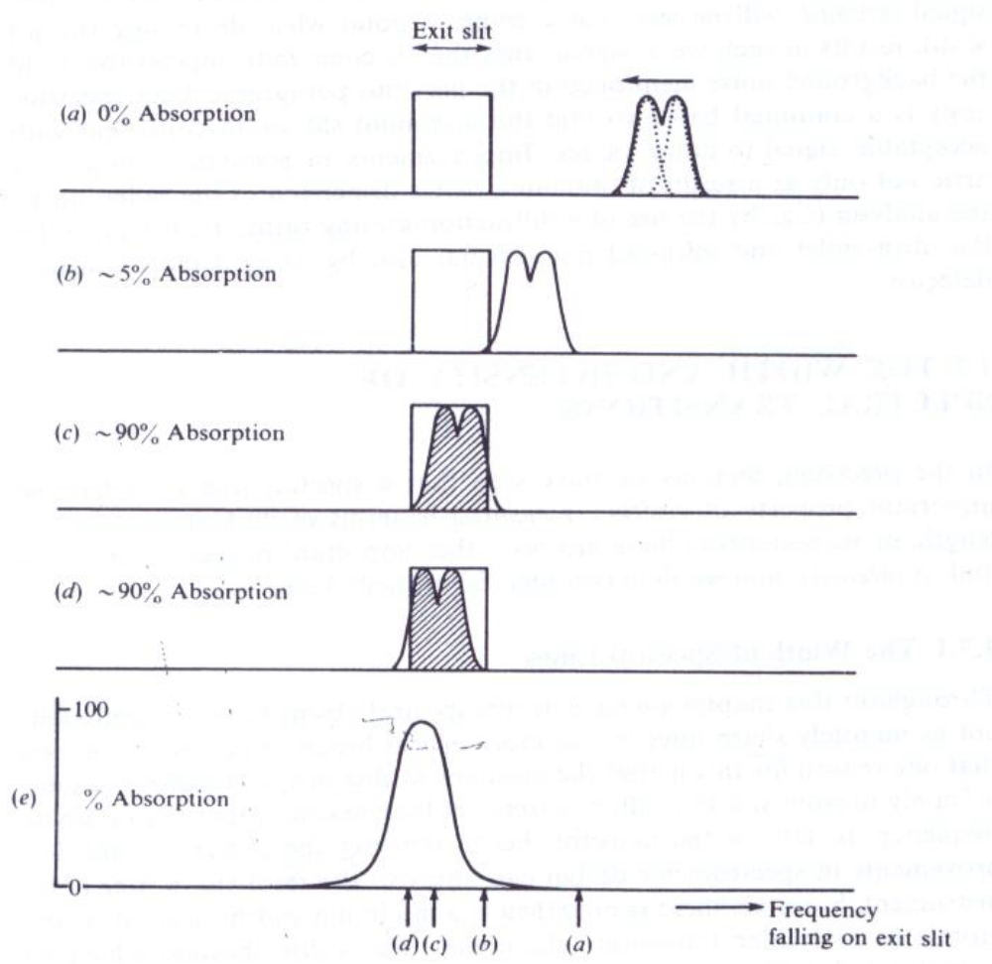
Signal-to-Noise: Resolving Power
Illustrating the relation between slit width and resolving power

Slide 41
Signal-to-Noise: Resolving Power
Scanning the spectrum plainly involves moving the twin absorbance peaks steadily to the left so that they pass across the exit slit and into the detector; the situation at successive stages is shown in (b), (c), and (d) of above Fig. the shaded area showing the amount of absorbance which the detector would register.
At (e) of this figure, the absorbance is plotted against frequency, together with the approximate positions of stages (a), (b), (c), and (d).
It is quite evident that the separation between the lines has disappeared under these conditions—-the lines are not resolved.
It is equally evident that the use of a much narrower slit would result in their resolution—the resolving power would be increased.

Slide 42
Signal-to-Noise: Resolving Power
In fact, provided the slit width is less than the separation between the lines, the detector output will show a minimum between them.
However, it must be remembered that a narrower slit allows less total energy from the beam to reach the detector and consequently the intrinsic signal strength will be less.
There comes a point when decreasing the slit width results in such weak signals that they become indistinguishable from the background noise.
Thus spectroscopy is a continual battle to find the minimum slit width consistent With acceptable signal-to-noise values. Improvements in resolving power may arise not only as a result of obtaining better dispersion of the radiation by the analyzer but also by using a more sensitive detector.

Slide 43
The Width and Intensity of Spectral Transitions
The Width of Spectral Lines:
Throughout this chapter we have drawn spectral absorptions and emissions not as infinitely sharp lines but as more or less broad peaks; we have seen that one reason for this is that the mechanical slits in spectrometers are not infinitely narrow and thus allow a range of frequencies, rather than a single frequency, to fall on the detector, hence blurring the pattern.
Improvements in spectrometer design can improve the resolving power of an instrument, however, there is nonetheless a minimum width inherent in any atomic or molecular transition—the natural line width—beyond which no instrument. This width arises essentially because the energy levels of atomic and molecular systems are not precisely determined, but have a certain fuzziness or imprecision.

Slide 44
The Width and Intensity of Spectral Transitions
1.Collision broadening:
Atoms or molecules in liquid and gaseous phases are in continual motion and collide frequently with each other. These collisions inevitably cause some deformation of the particles and hence perturb, to some extent, the energies of at least the outer electrons in each. This immediately gives a possible explanation for the width of visible and ultra-violet spectral lines, since these deal largely with transitions between outer electronic shells.
In general, molecular interactions are more severe in liquids than in gases, and gas-phase spectra usually exhibit sharper lines than those of the corresponding liquid. In the case of solids, the motions of the particles are more limited in extent and less random in direction, so that solid-phase spectra are often sharp but show evidence of interactions by the splitting of lines into two or more components.

Slide 45
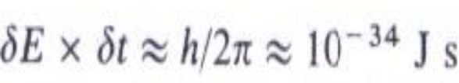
The Width and Intensity of Spectral Transitions
2. Doppler broadening:
Again in liquids and gases the motion of the particles causes their absorption and emission frequencies to show a Doppler shift; since the motion is random in a given sample, shifts to both high and low frequencies occur and hence the spectral line is broadened.
3.Heisenberg uncertainty principle.
Even in an isolated, stationary molecule or atom the energy levels are not infinitely sharp, due to the operation of a fundamental and very important principle, the Uncertainty Principle of Heisenberg. In effect this says that, if a system exists in an energy state for a limited time ẟt seconds, then the energy of that state will be uncertain (fuzzy) to an extent ẟE,
where h is again Planck's constant.

Slide 46
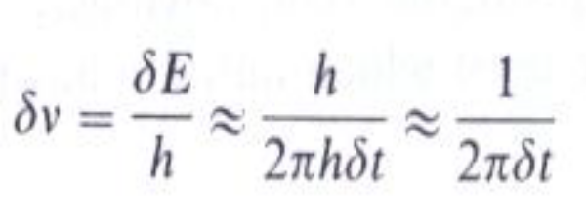
The Width and Intensity of Spectral Transitions
Thus we see that the lowest energy state of a system is sharply defined since, left to itself, the system will remain in that state for an infinite time; thus it ẟt = ∞, and ẟE = 0. But, for example, the lifetime of an excited electronic state is usually only about 10⁻⁸ s, which gives a value for ẟE of about 10⁻³⁴/10⁻⁸ = 10⁻²⁶ J.
A transition between this state and the ground state will thus have an energy uncertainty of ẟE , and a corresponding uncertainty in the associated radiation frequency of ẟE/h, which we can

Slide 47
The Width and Intensity of Spectral Transitions
The Intensity of Spectral Lines:
When discussing spectral intensities there are three main factors to be considered: the likelihood of a system in one state changing to another state— the transition probability; the number of atoms or molecules initially in the state from which the transition occurs—the population; and the amount of material present giving rise to the spectrum—the concentration or path length of the sample.
Transition probability:
The detailed calculation of absolute transition probabilities is basically a straightforward matter, but as it involves a knowledge of the precise quantum mechanical wave functions of the two states between which the transition occurs, it can seldom be done with accuracy.

Slide 48
The Width and Intensity of Spectral Transitions
however, it is often possible to decide whether a particular transition is forbidden or allowed (i.e., whether the transition probability is zero or non-zero). This process is essentially the deduction of selection rules, which allow us to decide between which levels transitions will give rise to spectral lines.
Population of states:
If we have two levels from which transitions to a third are equally probable, then obviously the most intense spectral line will arise from the level which initially has the greater population. There is a simple statistical rule governing the population of a set of energy levels.
For example, if we have a total of N molecules distributed between two different energy states, a lower and an upper with energies E_{lower} and E_{upper} respectively.

Slide 49
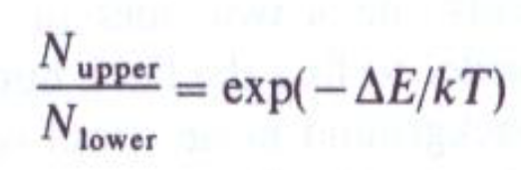
The Width and Intensity of Spectral Transitions
we would intuitively expect most of the molecules to occupy the lower state. Proper statistical analysis bears this out and shows that, at equilibrium;
where ΔE = E_{upper} - E_{lower},T is the temperature in K, and k is a universal constant.
The expression is known as the Boltzmann distribution, after its originator, and k, which has a value of 1.38 x 10⁻²³ J K⁻¹, as Boltzmann's constant.
Path length of sample:
Clearly if a sample is absorbing energy from a beam of radiation, the more sample the beam traverses the more energy will be absorbed from it. We might expect that twice as much sample would give twice the absorption, but a very simple argument shows that this is not so.

Slide 50
The Width and Intensity of Spectral Transitions
Consider two identical samples of the same material, S_{l} and S₂ , and assume that S_{l} or S₂ alone absorb 50 per cent of the energy falling on them, allowing the remaining 50 per cent to pass through. If we pass a beam of initial intensity I_{o} through S₁, 50 per cent of I_{o} will be absorbed and the intensity of the beam leaving S_{l} will be ½ I_{o}, if we then pass this beam through S₂ a further 50 per cent will be absorbed, and 1/2 ×1/2 I_{o} = ¼ I_{o} will leave S₂.
Thus two 50 per cent absorptions in succession do not add up to 100 per cent but only to 75 per cent absorption. An exactly similar relationship exists between the concentration of a sample and the amount of energy absorption—a doubling of the concentration produces something less than a doubling of the absorption.

Slide 51
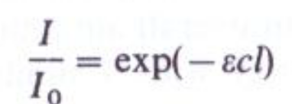
The Width and Intensity of Spectral Transitions
An exactly similar relationship exists between the concentration of a sample and the amount of energy absorption—a doubling of the concentration produces something less than a doubling of the absorption.
These relationships are best expressed in terms of the Beer—Lambert law, which is:
where I_{o} is the intensity of radiation falling on the sample, and I that part transmitted, c and l are the sample concentration and length, and ε is the extinction coefficient or absorption coefficient, which is a constant for a given type of transition (e.g., electronic, vibrational, etc.) occurring within a particular sample.

